Slide 1
Self-training with Noisy Student
Qizhe Xie and Eduard Hovy and Minh-Thang Luong and Quoc V. Le @ Google
Presented by Hristo S. Hristov

Slide 2

Another lecture on (deep) CNN-s

Slide 3
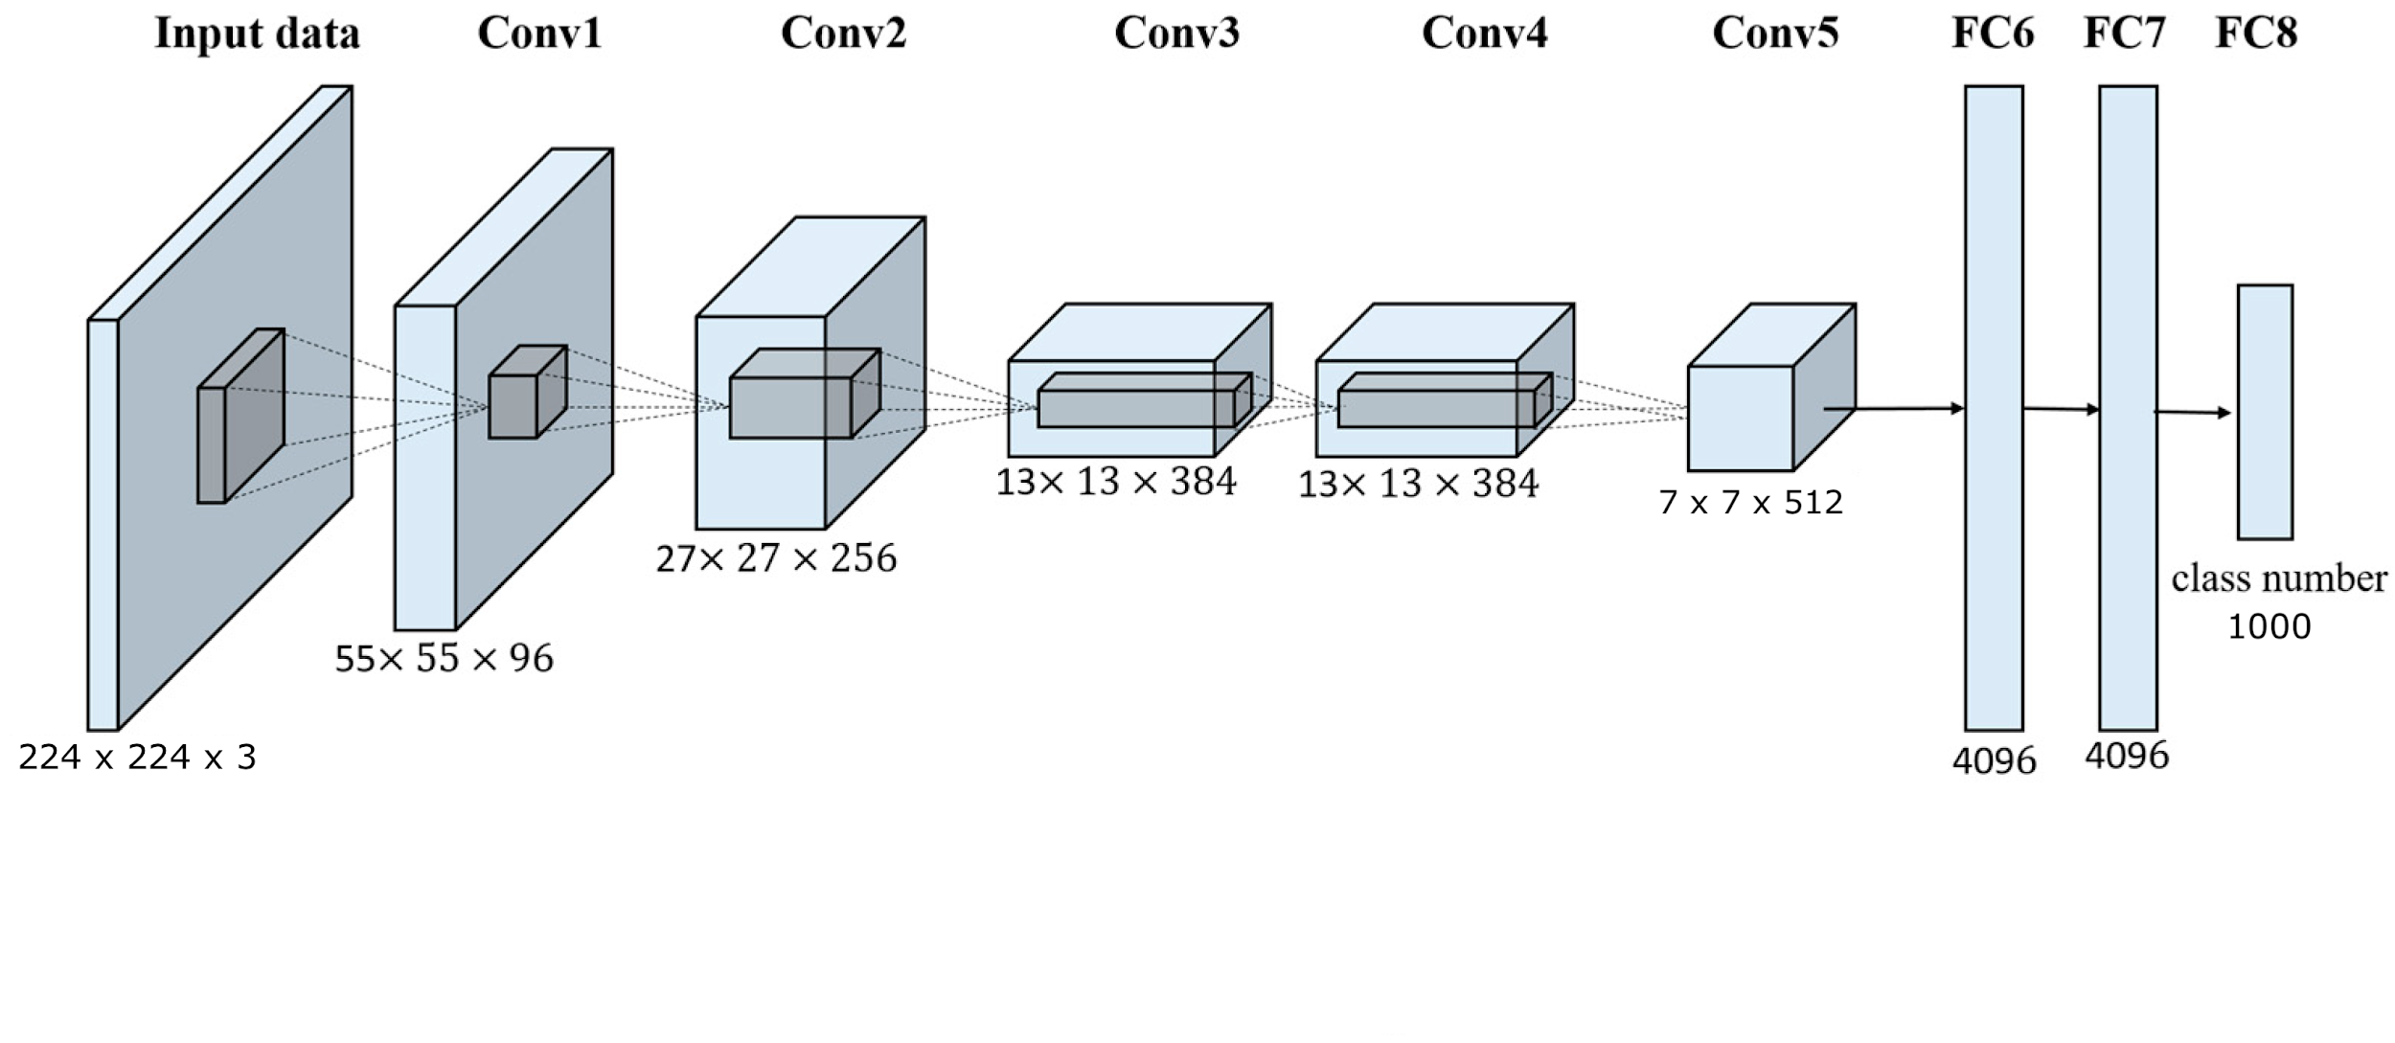
Another lecture on (deep) CNN-s

Slide 4
Part 1: EfficientNet
Published in May 2019, has 89 citations
Base architecture for the Noisy student model (later in presentation)
Original source : link

Slide 5
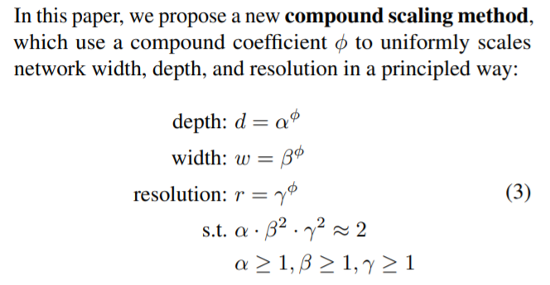
Solving compound scaling in CNN-s

Slide 6
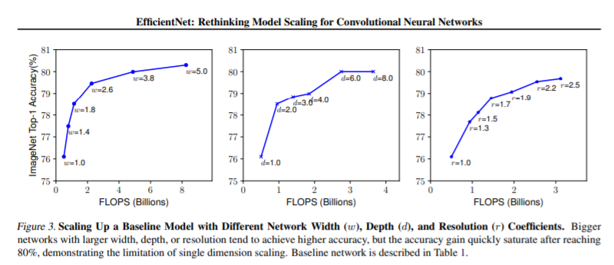
Compound Scaling

Slide 7
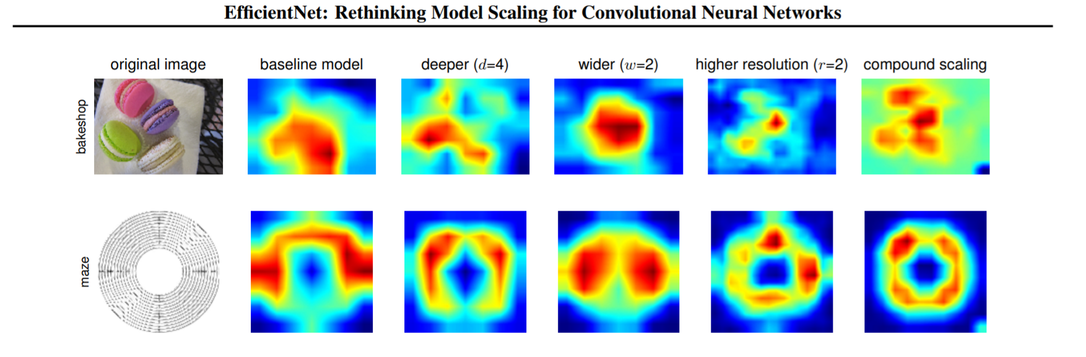
Example of EfficientNet advantages

Slide 8
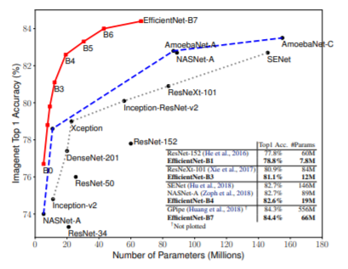
Scaling
18 times fewer FLOPS than previous state of the art

Slide 9
Part 2: The noisy student
November 2019

Slide 10
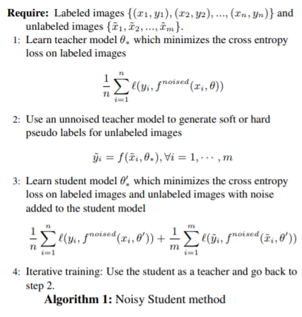

Slide 11
The teacher - student model
Expand training by using unlabelled data
Train an iteratively larger teacher model without adding noise to the data
Train a smaller student model which learns on labelled and unlabelled data
Original source: link

Slide 12
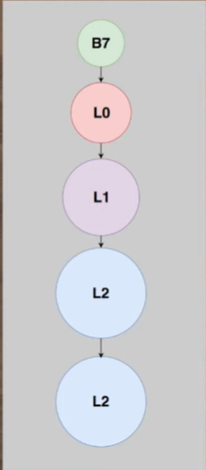
Grow the student networks
While it improves the accuracy try to use the next architecture

Slide 13
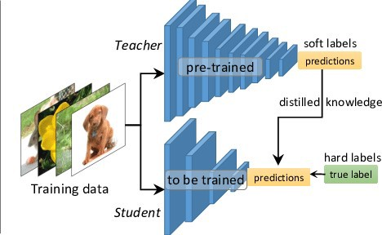
Knowledge distillation
Idea:
Make use of weakly supervised dataset

Slide 14
Noise is good
To the student network add:
Dropout
Stochastic depth
Data augmentation (RandAugment)

Slide 15
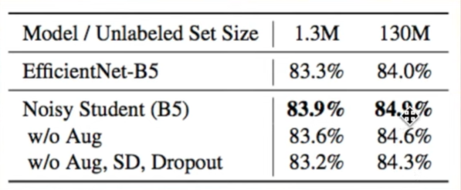
Results due to noise

Slide 16
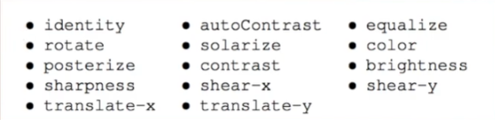
RandAugment
Augment input data optimally but not computationally expensively
What operations should be used?
How often should these operations be used?
Notes:
Find optimal policy

Slide 17
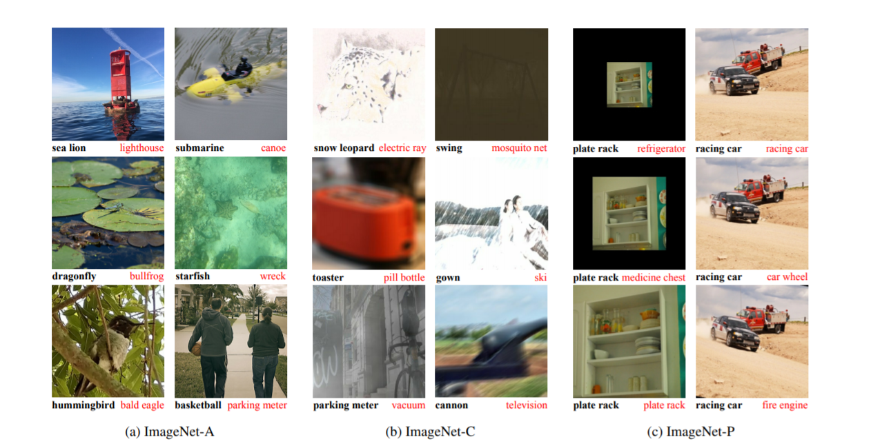
Results - old SOTA vs Noisy student

Slide 18
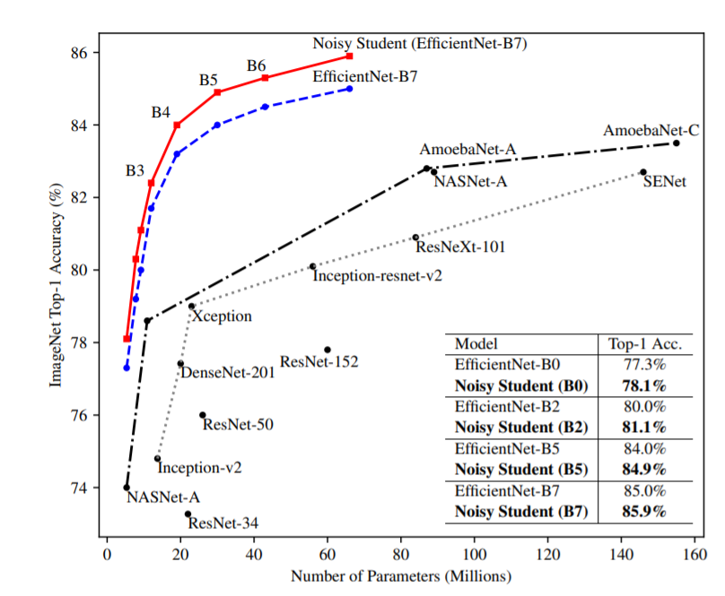
Scaling
18 times fewer FLOPS than previous state of the art

Slide 19
Part 3: Document classification

Slide 20
Transfer learning
What are trained neurons?
TL: Copy first N layers and add FC layers in the end of the network
Better at ImageNet => Better at other CV tasks

Slide 21
4 ideas to take home
Combining а lot of simple concepts the noisy student achieves the best possible accuracy with less computational power
Compound scaling
RandAugment
Teacher-student model
Transfer learning

Slide 22
Questions?

